Slide 1
Two things: 1. A Broadcast Receiver is expected to return immediately. Making it wait is just wrong. 2. You wont be able to invoke startActivityforResult() on the context object passed to the onReceive() method of the Broadcast receiver.

Slide 2
KEY | FUNCTION
KEYCODE_VOLUME_UP | 24
KEYCODE_VOLUME_DOWN | 25
KEYCODE_VOLUME_MUTE | 164
adb shell input keyevent 164
adb shell "input keyevent 67 && input keyevent 67"
adb shell getevent
input keyevent --longpress POWER

Slide 3
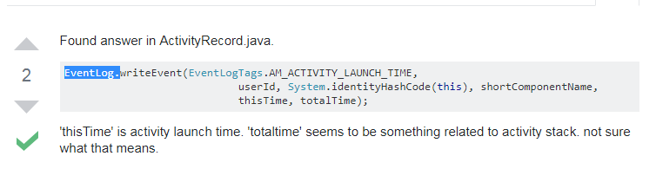
The startActivity(intent) and startActivityForResult(intent) methods are Asynchronous as they are non-blocking and allow the thread of execution to continue whilst performing their corresponding task as well.
Here's the Android source code in question: github.com/android/platform_frameworks_base/blob/master/… – Paul Lammertsma

Slide 4
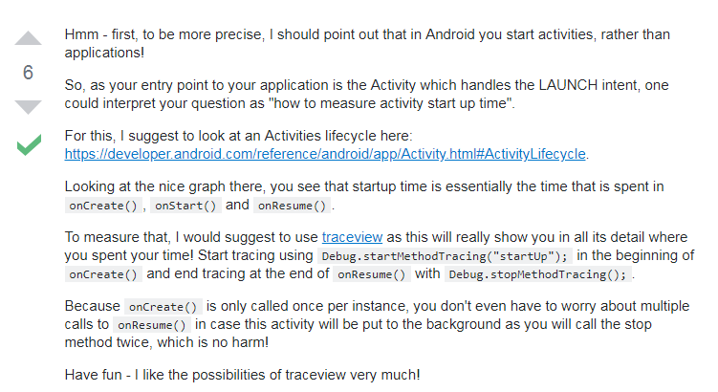

Slide 5
CLASS NAME
VolumeActivity | Dynamic
VolumeView | Static
MUTE
UNMUTE
VOLUME_UP
VOLUME_DOWN

Slide 6
traceview
https://developer.android.com/studio/profile/traceview
https://developer.android.com/studio/profile/cpu-profiler
Gongju
http://blog.udinic.com/2015/09/15/speed-up-your-app
https://www.youtube.com/watch?list=PLWz5rJ2EKKc9CBxr3BVjPTPoDPLdPIFCE&v=we6poP0kw6E

